Slide 1
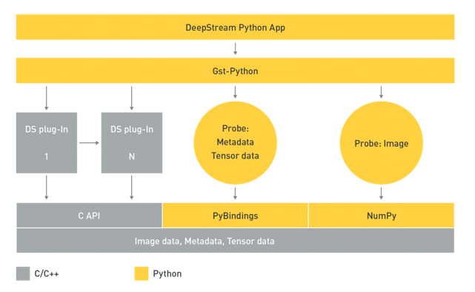
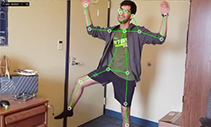
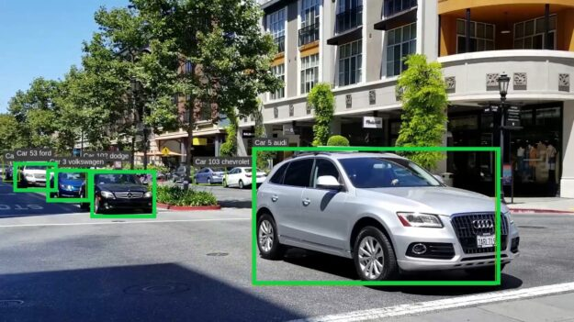
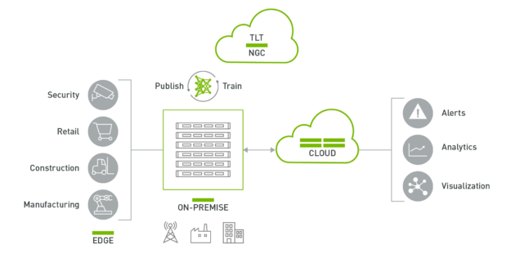
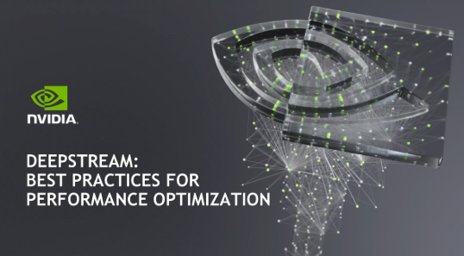
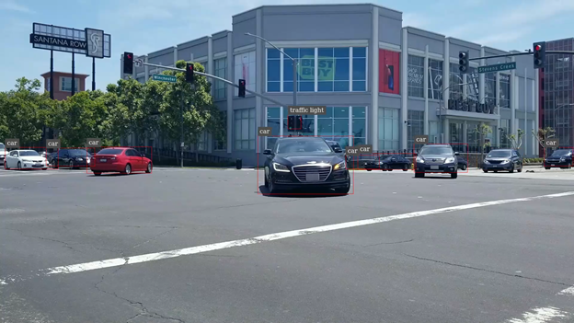
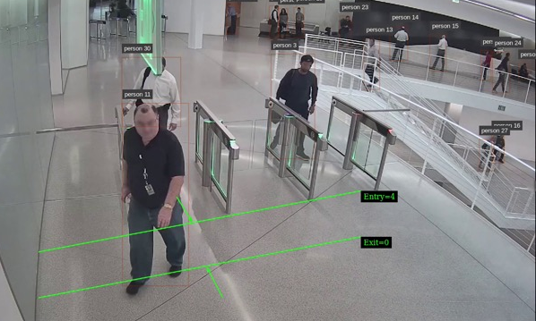
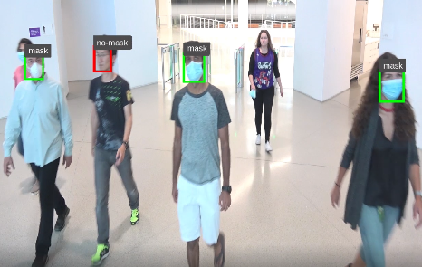
Developer resources
DeepStream Python Apps
Pose Estimation using DeepStream
Creating a Real-Time License Plate Detection and Recognition App
Building Intelligent Video Analytics Apps using DeepStream 5.0
DeepStream performance optimization tutorial
Deploying Models from TensorFlow Model Zoo Using NVIDIA DeepStream and NVIDIA Triton Inference Server
Creating Intelligent places using NVIDIA Pre-trained models and DeepStream SDK
Implementing real-time AI-based face mask detection
https://developer.nvidia.com/deepstream-getting-started

